Slide 1
Data Patterns
By: Caffeine Overflow
Dante Beltran, Hamza Salman, Kevin Truong, Mark Greenidge & Bochi Li

Slide 2

The Problem
High Learning Curve
Few Options to Visualize Data
Most Are Paid
Not Accessible to Average Consumer

Slide 3

The Idea
Turn raw data into useful information
Ease data science exploration, analysis and visualization for researchers not familiar with web programming.

Slide 4

High Level Description
Mongo DB
Python Back-end (Flask)
JavaScript Frontend(D3.Js)
Utilize high level technologies and present them in a way that is user friendly & interactive.

Slide 5
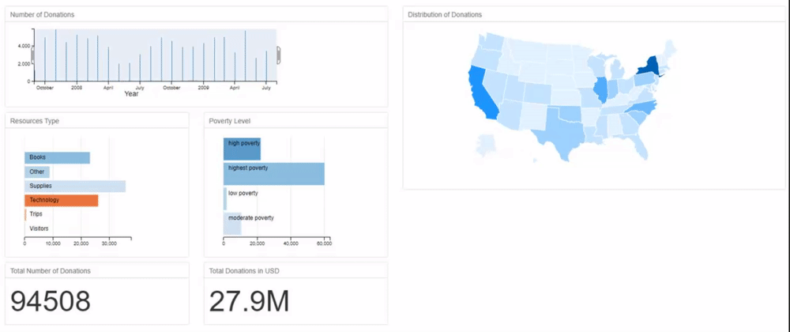
Sample Project

Slide 6

GOAL
Cost Effective Solution
Easily upload and understand data
Allow users to learn while exploring.

Slide 7
Thank You for Listening

